Slide 1
TELCO ANALYSIS
Suhana kumari

Slide 2
Objective
The objective of this analysis is to evaluate the potential for growth and profitability of TellCo, a mobile service provider operating in the Republic of Pefkakia. We aim to determine whether TellCo represents a valuable acquisition opportunity or if it would be more strategic to pursue alternative investments.
TellCo has provided its financial information for review but has not previously conducted a detailed analysis of their system-generated data. Understanding customer behavior, network utilization, and service performance is crucial for identifying areas of improvement and growth.
The goal of this analysis is to provide actionable insights that will guide the decision-making process regarding the acquisition of TellCo. By understanding the underlying data and identifying growth opportunities, we aim to determine whether TellCo is a worthwhile investment and how it can be optimized for increased profitability.

Slide 3
Analysis Goals
Customer Segmentation: Identify distinct customer segments based on their usage patterns and demographics. Determine which segments are the most profitable and which have potential for growth.
Usage Trends: Analyze patterns in network usage to identify peak periods, high-demand services, and underutilized areas.
Revenue Optimization: Evaluate current revenue streams and pricing strategies. Recommend adjustments to enhance profitability
Operational Efficiency: Assess network performance and identify areas where service quality can be improved or costs can be reduced.
Competitive Positioning: Compare TellCo’s performance with industry benchmarks to gauge its competitive standing and potential for market share expansion.

Slide 4
Flow Chart
Graph
Loading DataSet
Model Training
Model Evaluation
Data Preprocessing
Feature Engineering
Evaluate Model
metrics
Handling Missing
Values
Visualize
Distribution
Model Selection
Data Normalization
EDA
Deployment

Slide 5
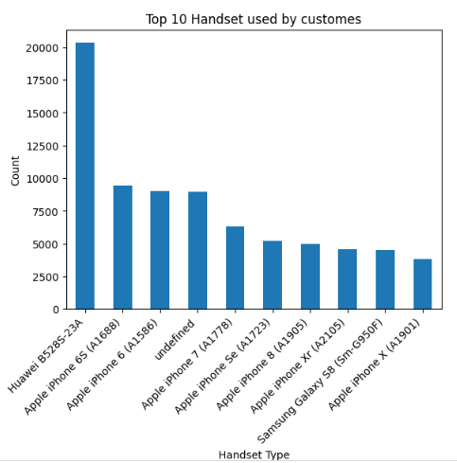
Top 10 Handset tType

Slide 6
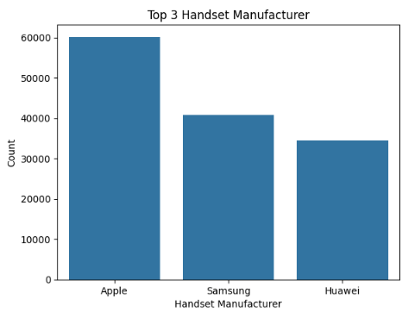
Top Handset Manufacturer Company

Slide 7
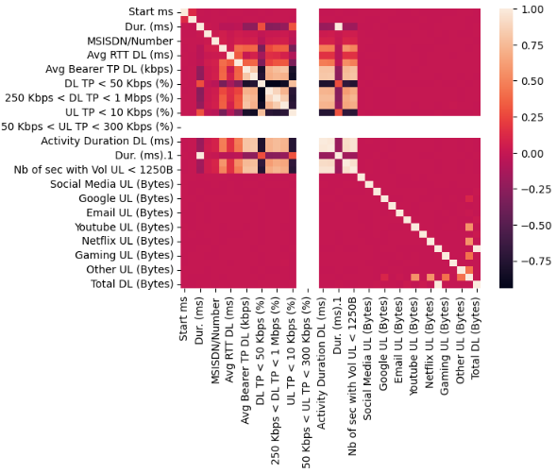
Correlation Analysis

Slide 8
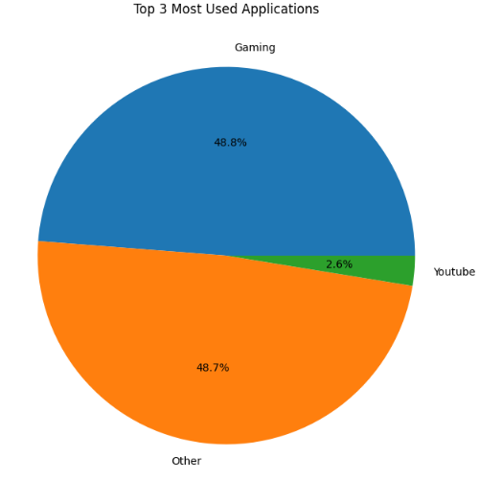
Distribution of Applications

Slide 9
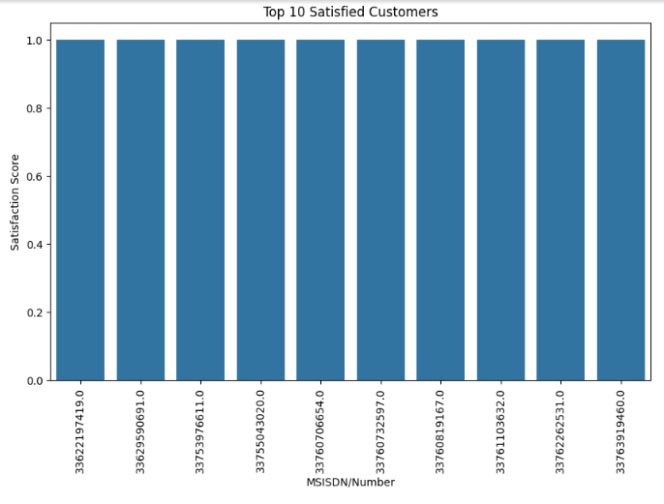
Top 10 Satisfied Customers

Slide 10
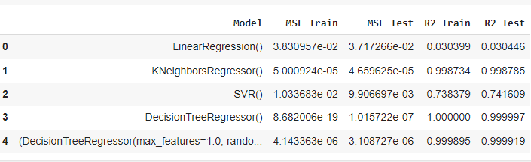
Model Performance

Slide 11
Conclusion
Linear Regression
The Mean Squared Error (MSE) is relatively high compared to other models, indicating that predictions are not very accurate. The R2 value is very low, meaning that the model explains very little of the variance in the target variable
Conclusion: Linear Regression is not performing well in this scenario
KNN Regressor
KNN has very low MSE for both training and testing datasets, indicating high accuracy in predictions. The R2 values are very high, suggesting that the model explains a significant portion of the variance in the data.
Conclusion: KNN is performing exceptionally well with low error rates and high R2 values.

Slide 12
Conclusion
SVR Regressor
SVR shows moderate MSE values. While not as low as KNN, they are still reasonable. The R2 values indicate that the model is explaining a decent portion of the variance.
Conclusion: SVR is performing reasonably well, though not as well as KNN.
Decision Tree Regressor
The training MSE is extremely low, close to zero, indicating that the model fits the training data almost perfectly. The testing MSE is also very low, suggesting excellent performance on unseen data. The R2 values are almost perfect, showing that the model explains nearly all the variance.
Conclusion: The Decision Tree Regressor performs very well, almost perfectly fitting both training and testing data

Slide 13
Conclusiom
Random Forest Regressor
This model also shows very low MSE for both training and testing datasets, even lower than the standard Decision Tree Regressor. The R2 values are very high, indicating excellent performance
Conclusion: This model, with hyperparameters tuned, performs slightly better than the basic Decision Tree Regressor

Slide 14
Model Selection
Summary Best Model: The Decision Tree Regressor with Hyperparameters appears to be the best overall, as it achieves the lowest MSE and highest R2 values for both training and testing datasets.
Why: It has extremely low error rates and very high explanatory power. The Decision Tree Regressor with tuned hyperparameters is better than the basic Decision Tree Regressor due to its slightly improved performance metrics.

Slide 15
Thanks !!!

